Slide 1

ANALYSIS OF HEALTHY LIFESTYLE ACROSS CITIES
DEEPIKA S

Slide 2

TABLE OF CONTENT
Agenda
Understanding the features
Process followed in the project
Detection from EDA process
Top five healthiest cities
Analyzing cities in asia
Model description
Conclusion

Slide 3
AGENDA
Health is an indicator of the quality of life indicators of health and morbidity refer to mental groups of healthy and sick people.
A healthier lifestyle is consistently associated with a longer life expectancy across various individual risks and irrespective of the presence of multiple long-term medical conditions.
A major factor behind longer life expectancy is happiness. Higher levels of happiness leads to higher life expectancy rates.
To determine the healthy life of the people across the world using different feature which leads to the healthy or unhealthy life.

Slide 4
UNDERSTANDING THE FEATURES
In order to determine the happiness levels the cities have been clustered based on the happiness level and longer life expectancy.
There is no categorical variable but we have cluster the cities based on the different features
The dataset consists of continuous variable so there is no categorical data.

Slide 5
PROCESS FOLLOWED IN THE PROJECT
Data Collection and preparation
EDA analysis
Elbow graph and silhouette score
Measuring the distance
Grouping based on minimum distance
Convergence
Reposition the centroids

Slide 6
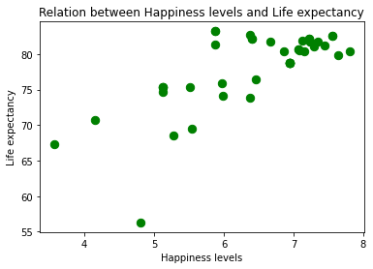
DETECTION FROM EDA PROCESS
This gives a relationship between all different features of overall healthy lifestyle of people in different cities. And clearly shows that all lead healthy life because of happiness level.
A major factor behind longer life expectancy is happiness. Higher levels of happiness leads to higher life expectancy rates.
This scatterplot clearly shows that higher levels of happiness leads to higher life expectancy.

Slide 7
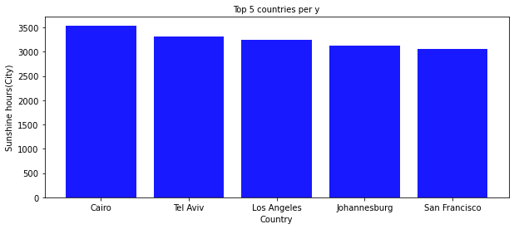
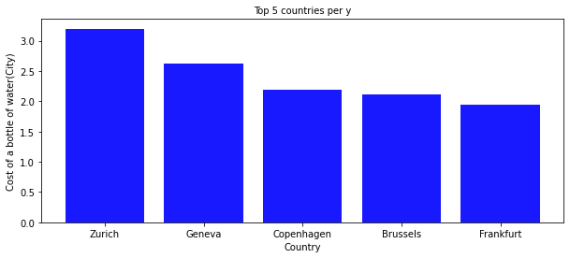
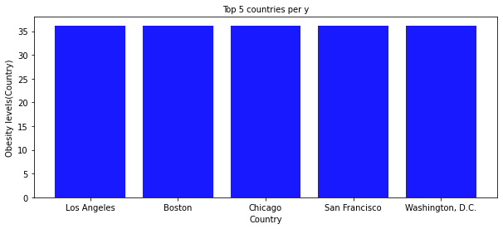
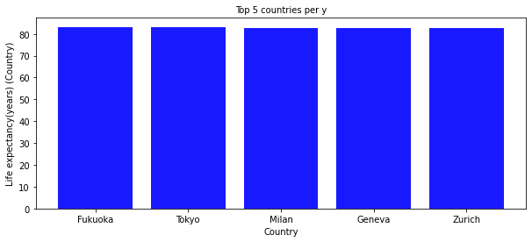
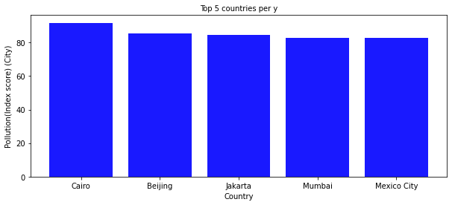
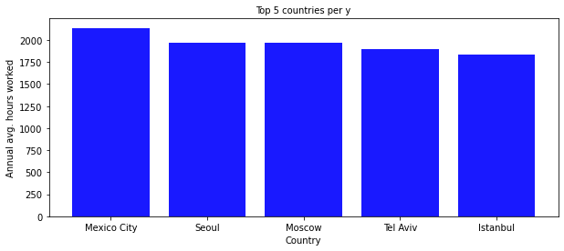
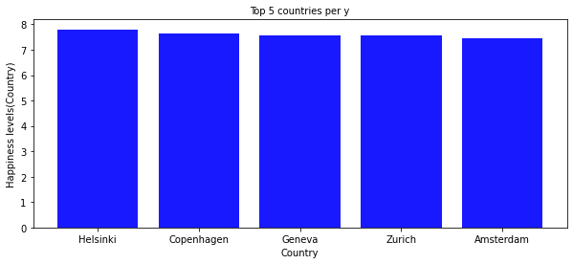
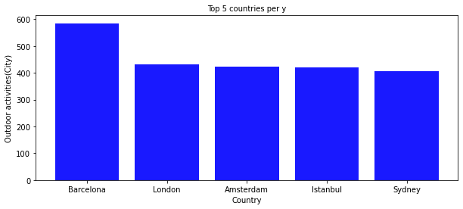
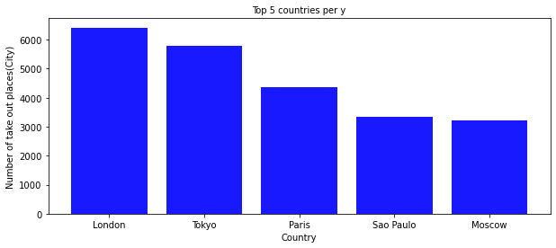
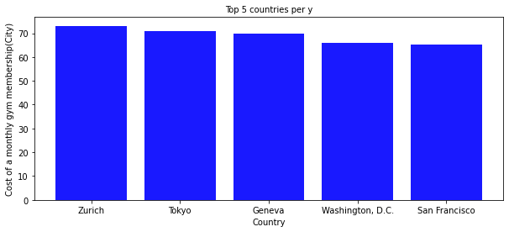
TOP FIVE HEALTHIEST CITIES
The following graph represent the top five cities based on column factors like sunshine hours, cost of a bottle of water, obesity levels, life expectancy, pollution score, annual avg hours worked, happiness level, outdoor activities, number of take out places, cost of a monthly gym membership and the same is done for least five cities

Slide 8
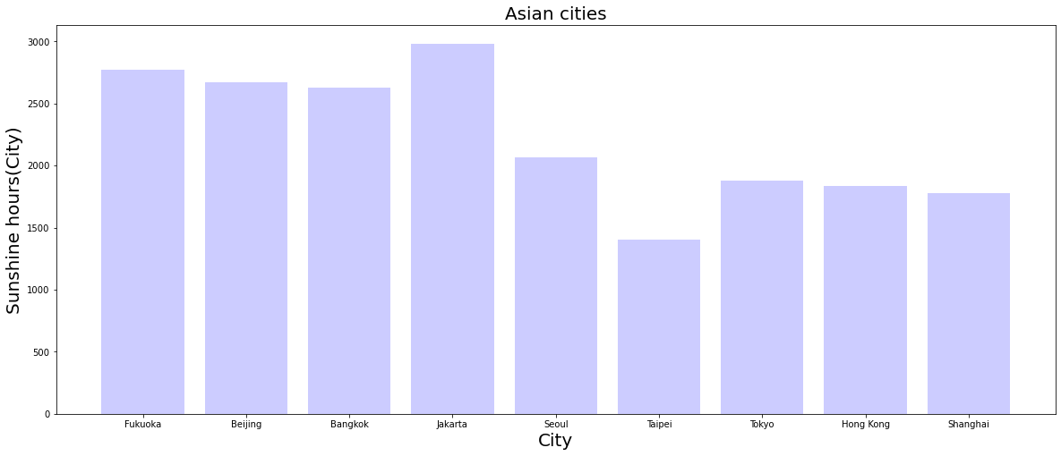
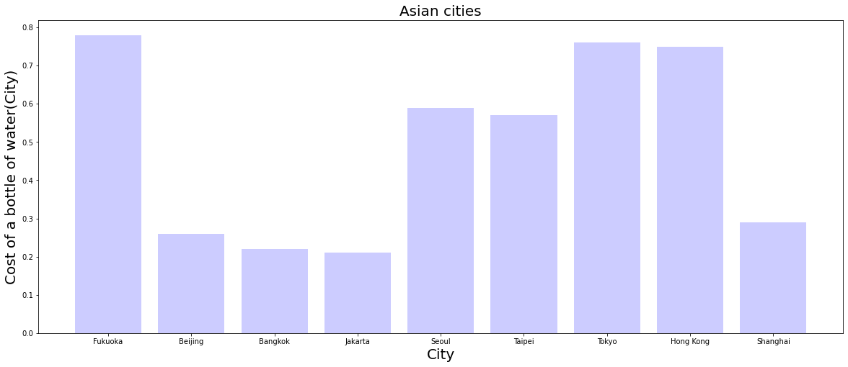
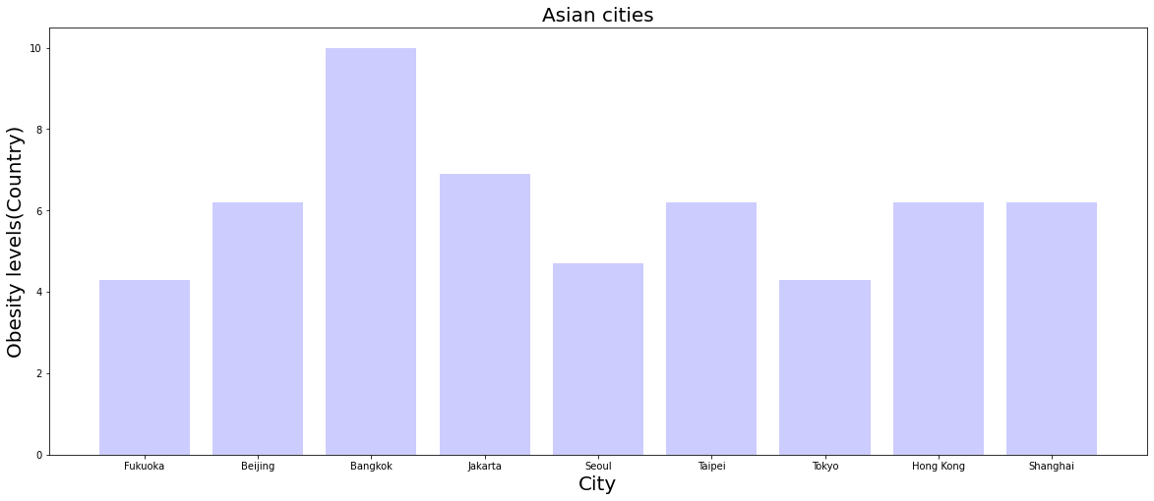
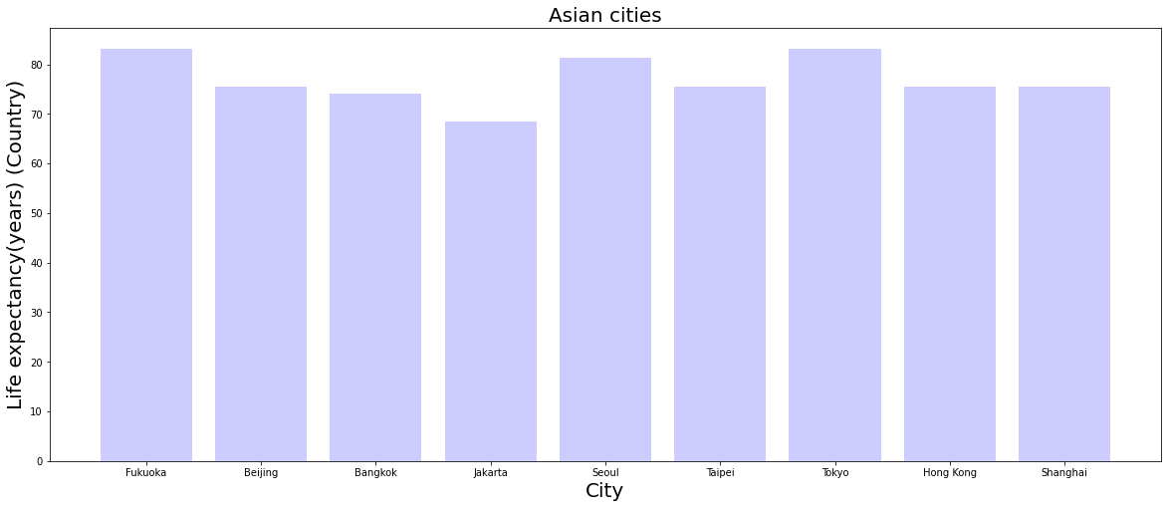
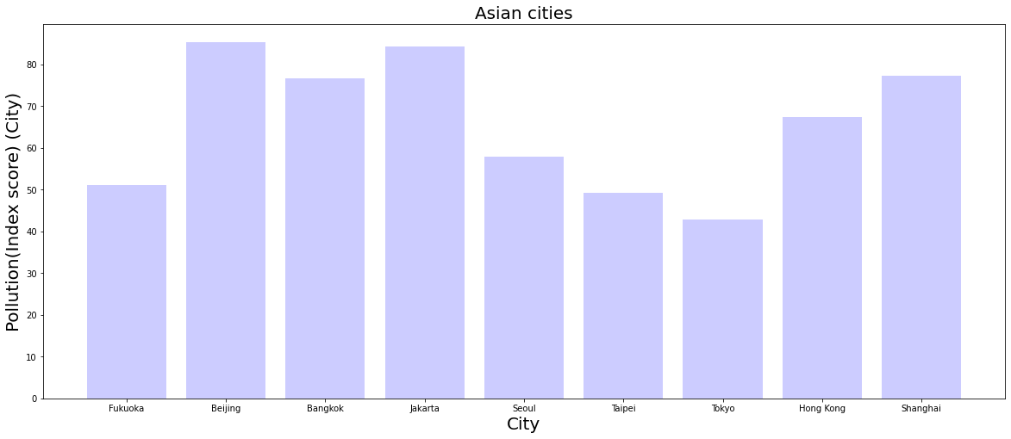
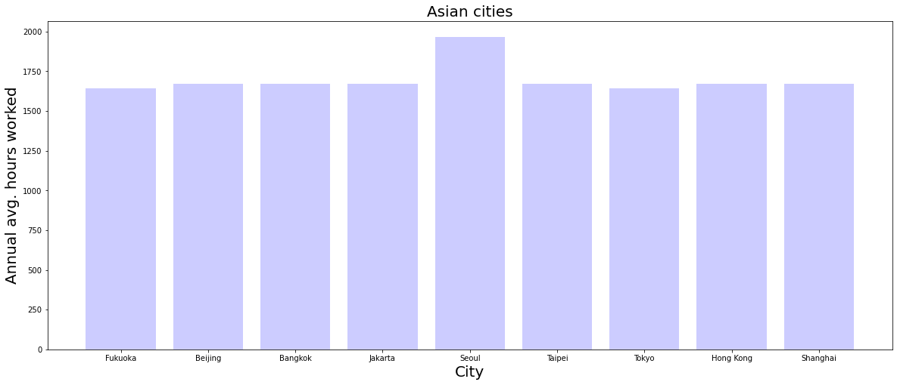
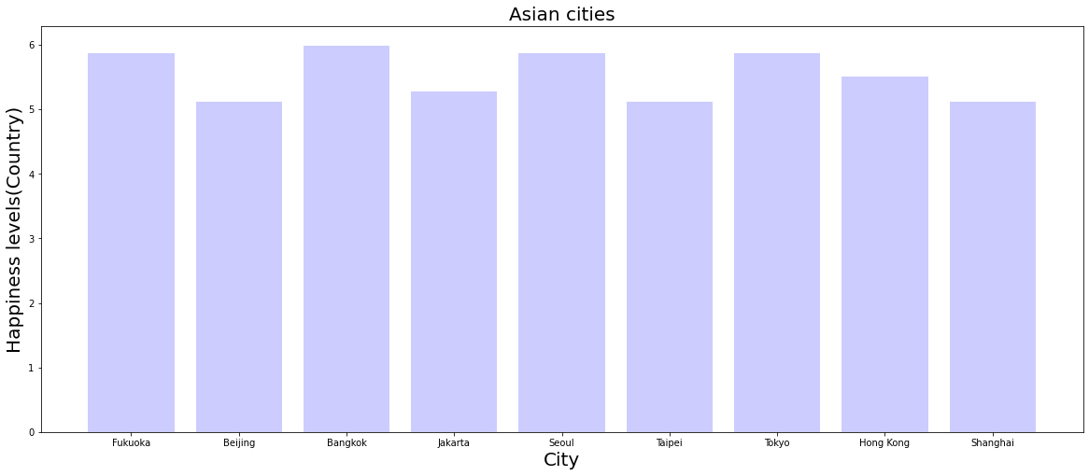
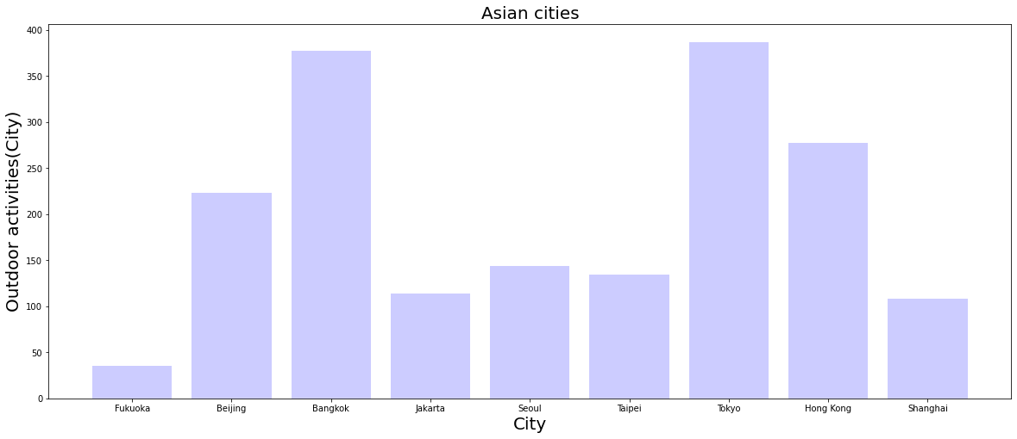
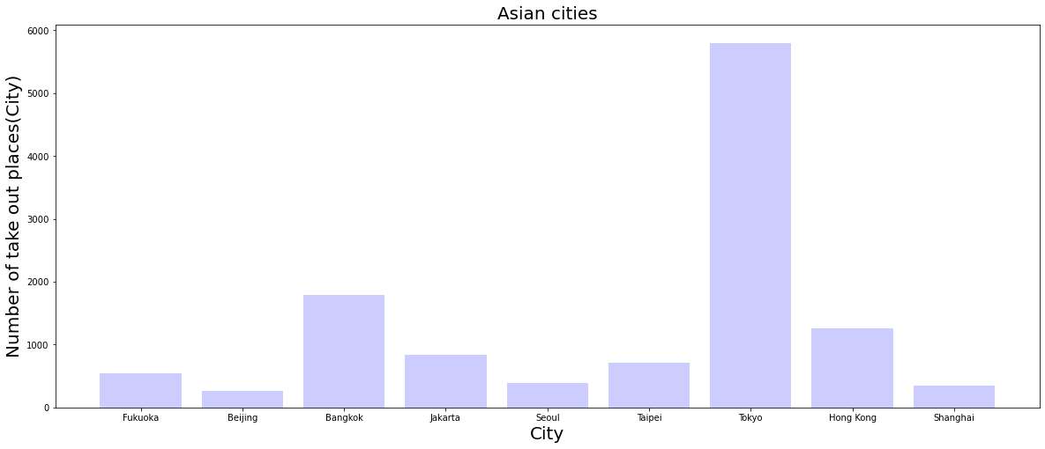
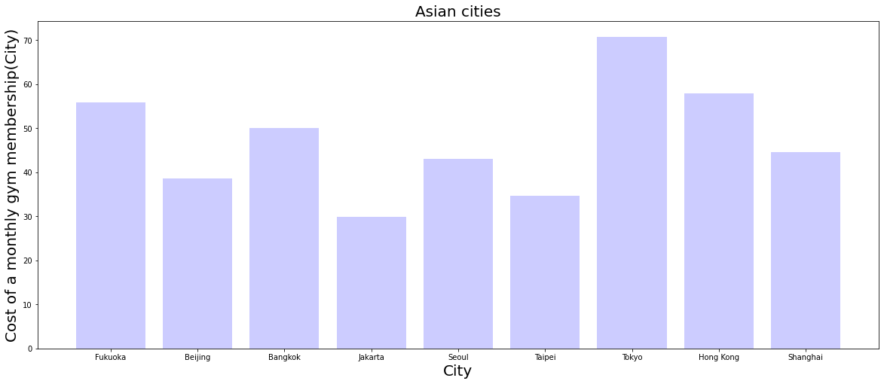
ANALYZING CITIES IN ASIA
In this dataset it consists of overall 44 cities across world, so we analyze cities only in asia by using different features

Slide 9
MODEL USED
The dataset consists of 44 cities across various countries and rate of healthy life is determined.
In order to determine the healthiest city we have used k-means clustering to cluster the cities based on different features
It is an unsupervised learning algorithm, which groups the unlabeled dataset into different clusters.
It allows us to cluster the data into different groups and a convenient way to discover the categories of groups in the unlabeled dataset on its own without the need for any training.

Slide 10
MODEL DESCRIPTION
Create silhouette visualization instance with k-means instance and fit the visualizer. And we have plotted the elbow graph to find the number of clusters.
Total we have five clusters so we have calculated silhouette score for each clusters
The cluster with maximum silhouette score is taken and compared with each columns, and clusters are visualized using barplot.

Slide 11
CONCLUSION
From this project we have successfully clustered cities based on healthy life style.
Because it consists of different features and continuous data so we use clustering to improve statistical analysis.
The number of clusters we have found is five. A healthier lifestyle is consistently associated with a longer life expectancy across various individual risks and irrespective of the presence of multiple long-term medical conditions.
The major factor behind longer life expectancy is happiness. Higher levels of happiness leads to higher life expectancy rates. The main aim is to find relationships between various factors that lead to healthy or unhealthy lifestyle in cities and visualize them.

Slide 12

THANK YOU

